Slide 1
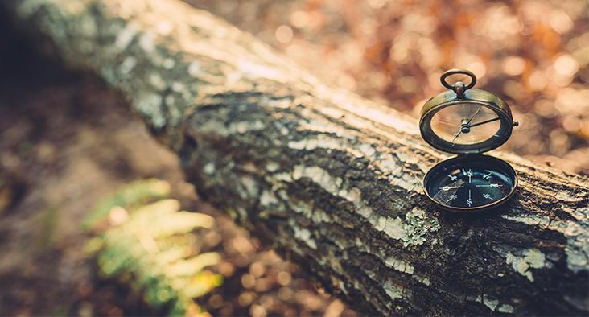
Code In Place Week 4:
Images!
Allen

Slide 2
Agenda
Recap
Week 4 Contents
Nested Loops
Image Processing
Basics
SimpleImage
Ed Collab
Image Filter
Trim Crop
Add Border

Slide 3
Week 3 Recap: Variable Mechanics
Loops and Variables
for loop: for i in range(x)
while loop (get their difference now?): while not scanned
variable declaration
be concise: fizz instead of fizzzzzz
be precise: total instead of subtotal

Slide 4
Nested Loops
While
For

Slide 5
Image Processing: Basics
Install Pillow (in PyCharm or Terminal (macOS) / cmd (Windows) / Shell (Linux)): python3 -m pip install Pillow
Test Pillow
python3 simpleimage.py for macOS and Linux
py simpleimage.py for Windows
SimpleImage installed, explore its functionality!
read an image (*explain the concept of object-oriented programming (OOP))
use for-each loop (basically a different kind of for loop) to iterate over the pixels
access a pixel by its x, y coordinates (image.get_pixel(x,y), mention OOP again)
set the value of a pixel (image.set_pixel(x,y,pixel))
range() function

Slide 6
Image Processing: SimpleImage
written by Nick Parlante
a Python Image Library (PIL)
greenscreening (L9P4)
mirroring (L9P5)

Slide 7
Section Filter
decomposition
concept of grayscaling
average out the effect of either color in R, G, B
so that the whole pixel looks gray (i.e., decent but trimmed information)

Slide 8
Trim Crop
decomposition
tackle with either nested for loop or single for loop
get familiar with the documentation of SimpleImage (maybe introduce OOP again if time allows)
check results by comparing your output with the ones available on the Ed page!

Slide 9
Extension
add border of the plot

Slide 10
Reminders
Assignment 3 is due on () get done with solutions and then come back

Slide 11
Unable to load section of Week 5
Final Project

